Slide 1
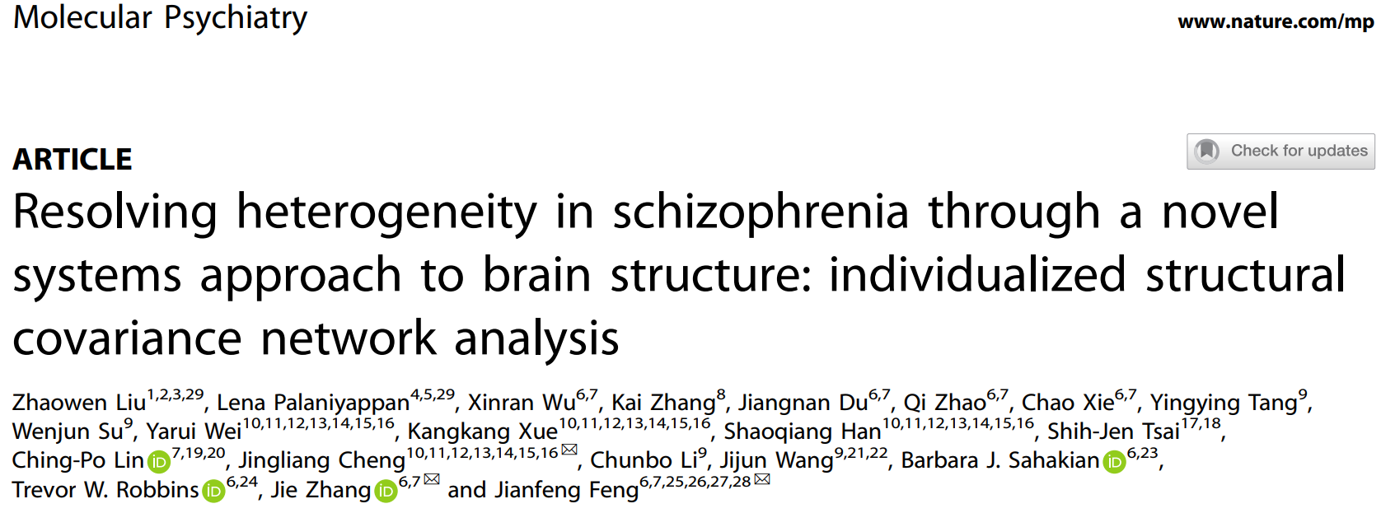
Resolving heterogeneity in schizophrenia through a novel systems approach to brain structure: individualized structural covariance network analysis
林李泽强
4月3日

Slide 2
Introduction
Schizophrenia is a heterogeneous illness with a highly complex genetic architecture and variable phenotypic expressions, thus lacks a unifying neuropathology.
Traditional case–control studies are not designed to identify individual differences among patients, as the structural covariance network is constructed almost exclusively at the group level, and thus can only be used to identify group-level differences such as abnormalities in frontal-temporal lobe covariance.
Mapping individual differences can facilitate finding clinical correlations, as well as identifying subgroups of patients with distinctive neuroanatomical patterns. (Author’s Motivation)
Notes:
结构协变在精分的应用： 精分是一种高度异质性的疾病，所以需要个体水平的度量！！

Slide 3
Introduction
Structural covariance networks were traditionally constructed at the group level thus cannot generate a normative distribution, thus normative model cannot be directly employed. Therefore, new approaches for constructing individual level structural covariance networks would hold great promise for uncovering subject-specific deviations in morphological covariance among regions. (Author’s Motivation)
Notes:
本文方法论的2点：构建个体水平的结构协变网络，度量病人结构协变网络的差异（使用标准模型）

Slide 4
Introduction
We first apply this method to a primary first-episode schizophrenia (FES) dataset (107 drug-naive patients and 71 controls) to test for the presence of distinct subtypes based on deviations in structural covariance.
We then studied the stability of the subtypes across illness stages in patients at a chronic (three datasets) and a clinical high-risk (CHR) (one dataset) stage. To establish clinical relevance, we contrasted the global symptom profiles of subtypes, without limiting the search to any specific symptoms.
Furthermore, we expected the overall degree of normative deviation to relate to hallucination severity based on several prior observations relating altered structural covariance to hallucinations.
We also undertook GWAS analysis and large-scale functional annotation analysis for the identified structural covariance edges, to help externally validate their biological meaning. (Analysis Outline)
Notes:
Trophic 营养

Slide 5
Introduction
In summary, we expected normative model based structural covariance to yield subtypes that are (1) stable across stages and (2) vary in symptom profile.
Notes:
Trophic 营养

Slide 6
Material and Method
Participants
Individuals were recruited from three hospitals including Shanghai Mental Health Center, the First Affiliated Hospital of Zhengzhou University, and Taipei Veteran General Hospital and from another two publicly available datasets, i.e., Center for Biomedical Research Excellence (COBRE) and Mind Clinical Imaging Consortium (MCIC). (数据集)

Slide 7
Material and Method
Participants
All participants were between the ages of 14 and 72 years. Data quality was ensured by screening raw data, registration, segmentation, and normalization quality, as well as by excluding left-handers and by matching age and sex. (质量控制)
After quality control, 1278 eligible subjects from different institutes completed their T1-weighted image scan and were involved in this study (320 first-episode drug-naive and 294 chronic schizophrenia patients, 99 CHR subjects and 565 matched health controls).

Slide 8
Material and Method
Participants
These involve seven datasets as follows:
our initial analysis was based on a primary FES dataset with genetic data (107 drug-naive patients and 71 healthy controls) collected from the Shanghai Mental Health Center. (实验数据集)
Validation dataset #1 consists of 91 subjects (44 drug-naive FES patients, 47 health controls) also from the Shanghai Mental Health Center. Validation dataset #2 contains 224 subjects from of Zhengzhou University (166 drug-naive FES patients, 58 health controls). (验证数据集)
Moreover, three chronic and one CHR datasets were used to explore the stability of our results across different disease stages. Chronic dataset #1 involves 256 subjects from Taipei Veteran General Hospital (124 schizophrenia patients, 132 health controls). Chronic dataset #2 involves 141 subjects from the COBRE (67 patients and 74 controls). Chronic dataset #3 involves 192 subjects from the MCIC (103 patients and 89 controls). Finally, a CHR dataset consists of 196 subjects from the Shanghai Mental Health Center (99 high-risk individuals, and 97 controls). (敏感性分析数据集)
Notes:
7个数据集: 1个发现数据集, 2个重建数据集, 4个敏感性分析数据集
为什么不用郑州大学那一批数据作为发现数据集?

Slide 9
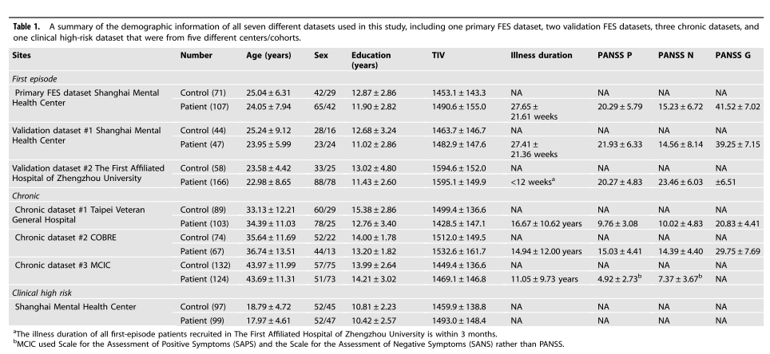
Material and Method
Table 1

Slide 10
Material and Method
T1 data acquisition and preprocessing
Individuals were all scanned by 3T and 1.5T magnetic resonance scanners:
Shanghai Mental Health Center (GE Sigma 3T),
the First Affiliated Hospital of Zhengzhou University (GE MR750 3T),
National Yang-Ming University in Taiwan (3T Siemens),
COBRE (3T Siemens Trio),
MIMC (3T Siemens Trio and 1.5T Siemens). The imaging parameters for all datasets are provided in Supplemental Methods. (不同的机器与不同的参数!!!)

Slide 11
Material and Method
T1 data acquisition and preprocessing
The voxel-based morphometry preprocessing of T1-weighted structural data was carried out using CAT12, which includes:
(1) the T1-weighted images were segmented into GM, white matter (WM), and non-brain voxels (cerebrospinal fluid, skull) using the “new-segment” routine.
(2) Population templates (GM, WM) were generated from each of the dataset separately using the DARTEL algorithm.
(3) The gray-matter images were aligned to a nonlinear deformation field and normalized to MNI space.
(4) The normalized images were all smoothed according to an isotropic Gaussian kernel (full-width at half-maximum = 8 mm).
The spatially normalized, smoothed, and Jacobian scaled gray-matter images (voxel size: 1.5 × 1.5 ×1.5 mm, each image had 2,122,945 voxels) were obtained for each subject. The summary statistics for the quality assurance of all the datasets from CAT12 are provided in Supplementary Table S1.

Slide 12
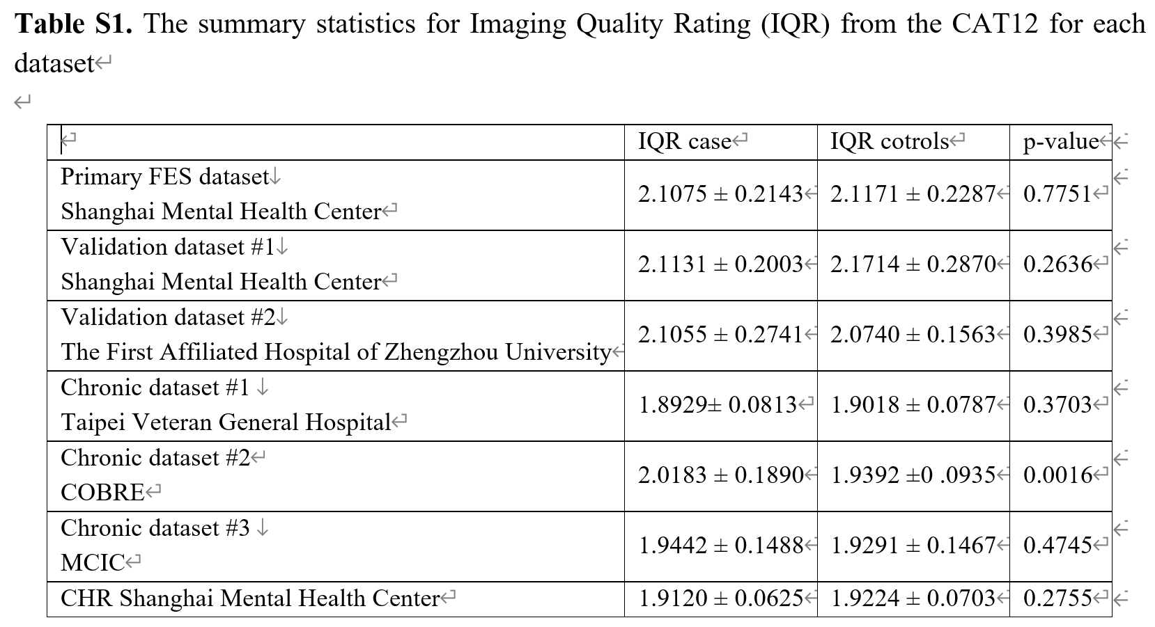
Material and Method
Summary statistics for the quality assurance

Slide 13
Material and Method
T1 data acquisition and preprocessing
Since voxels with low value of gray matter have variances close to zero and do not apply to the Gaussian error distributions, we masked those low valued voxels with the SPM Masking Toolbox with a software suggested threshold of 0.22. As a result, each retained image had a total of 433,584 voxels for further statistical analysis. (去除边缘体素)
The automated anatomical labeling2 (AAL2) atlas, which partitioned the brain into 94 regions of interest (47 in each hemisphere), was used to identify the brain regions. (提脑区值)
Genetic data and the corresponding preprocessing pipelines can be seen in Supplemental Methods.

Slide 14
Material and Method
Genetic data acquisition and preprocessing
The 300ng genomic DNA were sheared with Covaris LE220 Sonicator (Covaris) to target of 150-200bp average size. DNA libraries were prepared using SureSelectXT Human All Exon V6+UTR (Agilent). The fragments were repaired the 3’and 5’overhangs using End repair mix (component of SureselectXT) and purified using Agencourt AMPure XP Beads (Beckman). The purified fragments were added with ’A’ tail using A tailing Mix (component of SureSelectXT) and then ligated with adapter using the DNA ligase (component of SureselectXT). The adapter-ligated DNA fragments were amplified with Herculase II Fusion DNA Polymerase (Agilent). Finally, the pre-capture libraries containing exome sequences were captured using SureSelect capture library kit (Agilent). DNA concentration of the enriched sequencing libraries was measured with the Qubit 2.0 fluorometer dsDNA HS Assay (Thermo Fisher Scientific). Size distribution of the resulting sequencing libraries was analyzed using Agilent BioAnalyzer 2100 (Agilent). The libraries were used in cluster formation on an Illumina cBOT cluster generation system with HiSeq PE Cluster Kits (illumina). Paired-end sequencing is performed using an Illumina NovaSeq6000 system following Illumina-provided protocols for 2x150 paired-end sequencing. In this analysis, the workflow of Sentieon (201611.02)3 was carried out to detect SNP (Single Nucleotide polymorphism). Further, SNPs with call rate < 95%, minor allele frequency <5%, or deviation from the Hardy-Weinberg equilibrium with p<10-6, were excluded from the analysis.
Finally, after quality control, we obtained 185,145 SNPs in 107 patients.
Notes:
300ng 基因组 DNA 用 Covaris LE220 Sonicator (Covaris) 剪切到 150-200bp 平均大小的目标。 使用 SureSelectXT 人全外显子 V6+UTR（安捷伦）制备 DNA 文库。 使用末端修复混合物（SureselectXT 的组分）修复片段的 3' 和 5' 突出端，并使用Agencourt AMPure XP Beads（Beckman）进行纯化。 使用 A 加尾混合物（SureSelectXT 的组分）为纯化的片段添加“A”尾，然后使用 DNA 连接酶（SureselectXT 的组分）与接头连接。 接头连接的 DNA 片段用 Herculase II Fusion DNA 聚合酶（安捷伦）扩增。 最后，使用 SureSelect 捕获文库套件（安捷伦）捕获包含外显子组序列的预捕获文库。 使用 Qubit 2.0 荧光计 dsDNA HS Assay (Thermo Fisher Scientific) 测量富集测序文库的 DNA 浓度。 使用 Agilent BioAnalyzer 2100 (Agilent) 分析所得测序文库的大小分布。 这些文库在带有 HiSeq PE Cluster Kits (illumina) 的 Illumina cBOT 簇生成系统上用于簇形成。 使用 Illumina NovaSeq6000 系统按照 Illumina 提供的 2x150 双端测序方案进行双端测序。 在该分析中，执行 Sentieon (201611.02)3 的工作流程来检测 SNP（单核苷酸多态性）。 此外，从分析中排除了调用率 < 95%、次要等位基因频率 <5% 或偏离 Hardy-Weinberg 平衡且 p<10-6 的 SNP。

Slide 15
Material and Method
数据总结:
7个数据集的subjects×94 regions的GMV数据；
实验数据集107个首发精神分裂症的SNPs数据;
7个数据集的病人PANSS(如焦虑、抑郁、幻想打分)
Notes:
300ng 基因组 DNA 用 Covaris LE220 Sonicator (Covaris) 剪切到 150-200bp 平均大小的目标。 使用 SureSelectXT 人全外显子 V6+UTR（安捷伦）制备 DNA 文库。 使用末端修复混合物（SureselectXT 的组分）修复片段的 3' 和 5' 突出端，并使用Agencourt AMPure XP Beads（Beckman）进行纯化。 使用 A 加尾混合物（SureSelectXT 的组分）为纯化的片段添加“A”尾，然后使用 DNA 连接酶（SureselectXT 的组分）与接头连接。 接头连接的 DNA 片段用 Herculase II Fusion DNA 聚合酶（安捷伦）扩增。 最后，使用 SureSelect 捕获文库套件（安捷伦）捕获包含外显子组序列的预捕获文库。 使用 Qubit 2.0 荧光计 dsDNA HS Assay (Thermo Fisher Scientific) 测量富集测序文库的 DNA 浓度。 使用 Agilent BioAnalyzer 2100 (Agilent) 分析所得测序文库的大小分布。 这些文库在带有 HiSeq PE Cluster Kits (illumina) 的 Illumina cBOT 簇生成系统上用于簇形成。 使用 Illumina NovaSeq6000 系统按照 Illumina 提供的 2x150 双端测序方案进行双端测序。 在该分析中，执行 Sentieon (201611.02)3 的工作流程来检测 SNP（单核苷酸多态性）。 此外，从分析中排除了调用率 < 95%、次要等位基因频率 <5% 或偏离 Hardy-Weinberg 平衡且 p<10-6 的 SNP。

Slide 16
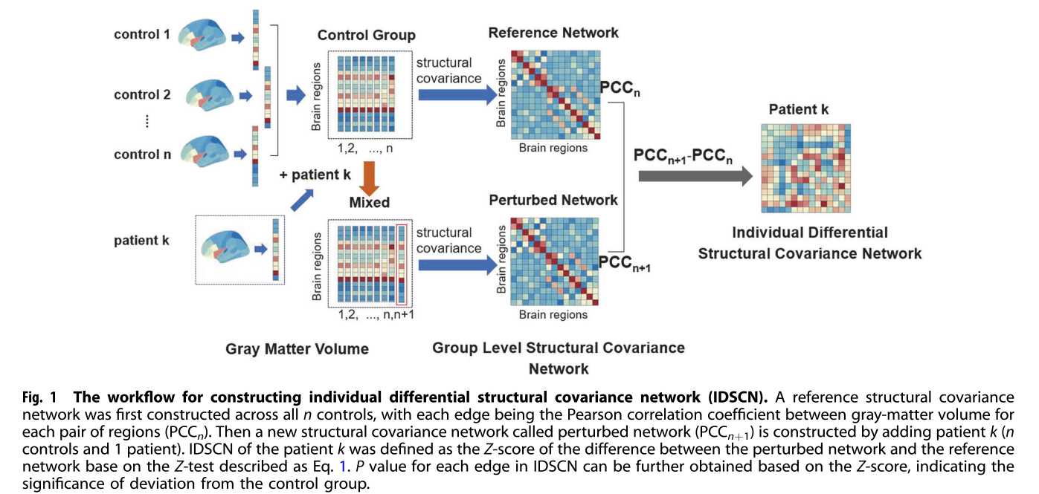
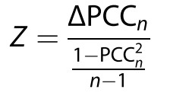
Material and Method
Statistical analysis:
Constructing the individual differential structural covariance network (IDSCN)
The mains steps for constructing the IDSCN for each patient with a control group of n subjects are as follows:
First, a reference structural covariance network PCC_{n} was constructed across the whole control group (i.e., n controls), which was obtained by calculating the correlation (partial Pearson correlation coefficient, PCC) between gray matter volume for each pair of brain regions with age, gender, education, and total intracranial volume (TIV) being covariates.
Then, we added patient k to the control group, and used n+ 1 subjects (n controls and 1 patient) to construct a new structural covariance network, which we termed as the perturbed network PCC_{n+1}.
Next, the difference between the perturbed network and the reference network was calculated, i.e., ΔPCC_{n} = PCC_{n+1} – PCC_{n}.
Finally, as previous work has theoretically confirmed that ΔPCC_{n} follows a new type of symmetrical distribution called the “volcano distribution,” the tail of which is similar to that of the normal distribution, the Z-score of ΔPCC_{n} was calculated based on the Z- test (or U-test) as follows

Slide 17
Material and Method
Statistical analysis:
Constructing the individual differential structural covariance network (IDSCN)
The mains steps for constructing the IDSCN for each patient with a control group of n subjects are as follows:
First, a reference structural covariance network PCC_{n} was constructed across the whole control group (i.e., n controls), which was obtained by calculating the correlation (partial Pearson correlation coefficient, PCC) between gray matter volume for each pair of brain regions with age, gender, education, and total intracranial volume (TIV) being covariates.
Then, we added patient k to the control group, and used n+ 1 subjects (n controls and 1 patient) to construct a new structural covariance network, which we termed as the perturbed network PCC_{n+1}.
Next, the difference between the perturbed network and the reference network was calculated, i.e., ΔPCC_{n} = PCC_{n+1} – PCC_{n}.
Finally, as previous work has theoretically confirmed that ΔPCC_{n} follows a new type of symmetrical distribution called the “volcano distribution,” the tail of which is similar to that of the normal distribution, the Z-score of ΔPCC_{n} was calculated based on the Z- test (or U-test) as follows

Slide 18
Material and Method
Statistical analysis:
Constructing the individual differential structural covariance network (IDSCN)
The mains steps for constructing the IDSCN for each patient with a control group of n subjects are as follows:
First, a reference structural covariance network PCC_{n} was constructed across the whole control group (i.e., n controls), which was obtained by calculating the correlation (partial Pearson correlation coefficient, PCC) between gray matter volume for each pair of brain regions with age, gender, education, and total intracranial volume (TIV) being covariates.
Then, we added patient k to the control group, and used n+ 1 subjects (n controls and 1 patient) to construct a new structural covariance network, which we termed as the perturbed network PCC_{n+1}.
Next, the difference between the perturbed network and the reference network was calculated, i.e., ΔPCC_{n} = PCC_{n+1} – PCC_{n}.
Finally, as previous work has theoretically confirmed that ΔPCC_{n} follows a new type of symmetrical distribution called the “volcano distribution,” the tail of which is similar to that of the normal distribution, the Z-score of ΔPCC_{n} was calculated based on the Z- test (or U-test) as follows

Slide 19
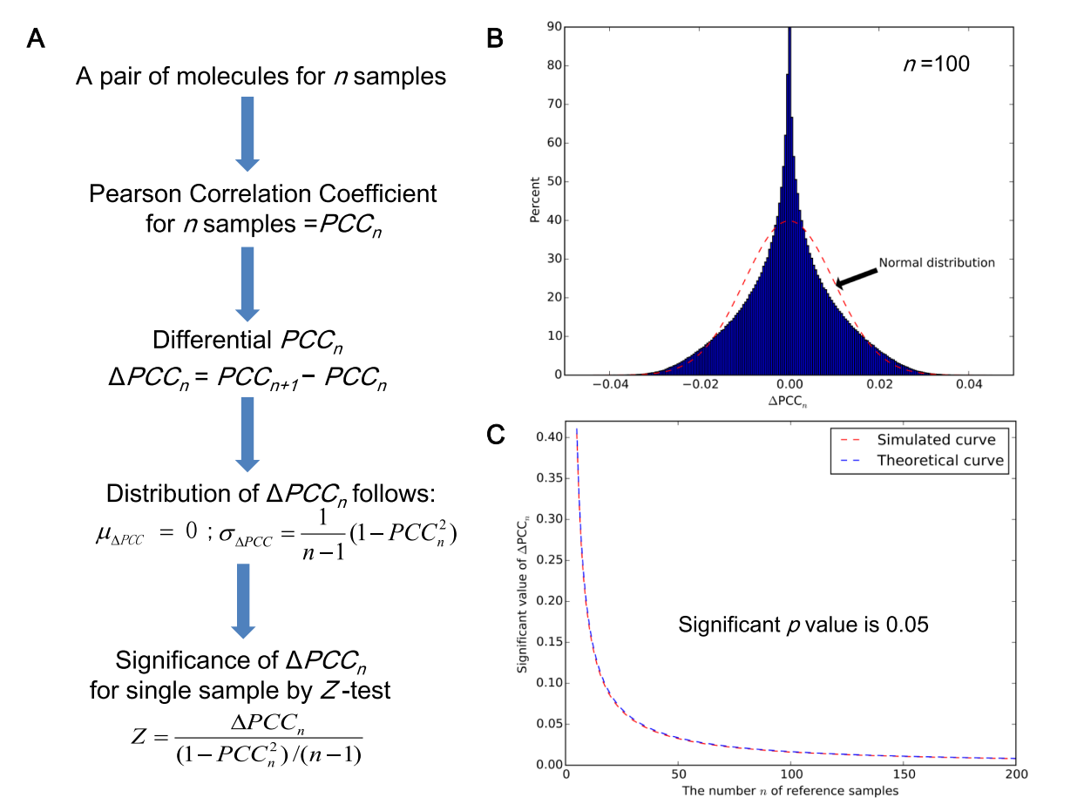

Slide 20
Material and Method
Statistical analysis:
Constructing the individual differential structural covariance network (IDSCN)
The IDSCN network for patient k was then constructed with the weight of each edge was the Z-scores obtained from the Z-test. We further obtained the P-value for each edge in the IDSCN network for patient k from the Z-score. (Z值转p值)
Finally, we identified edges in each patient’s IDSCN that were significantly different from the reference network following Bonferroni correction. (多重比较校正)
We constructed the IDSCN for each patient, with 4371 edges between the 94 different brain regions. The edges obtained in each individual network indicate how the covariance between the two connected nodes in a specific patient deviates from the normative covariance observed in unaffected control group, i.e., the weight of subject-specific deviation from the normative covariance of any two nodes.(结构连接的解释)

Slide 21
Material and Method
Statistical analysis:
Subtyping patients using the IDSCN
After constructing IDSCN, we then subgroup the patients based on the selected covariance edges. Specifically,
for each edge in the IDSCN, we first counted the number of patients with significant change (P < 0.05, Bonferroni corrected) for this edge. (数边数)
We then used the top 20 edges (in terms of the number of affected patients for the edges) as the features to perform k-means clustering analysis (within each dataset), with one minus the Pearson correlation being the distance. We chose the top 20 edges only. The number of clusters was set between 2 and 5 in the analysis and 100 times of clustering were performed to obtain the final clustering index under each clustering number. The optimal number of clusters had the largest mean silhouette value. (K-means聚类)

Slide 22
Material and Method
Statistical analysis:
Subtyping patients using the IDSCN
After dividing the patients into different subgroups, two tailed, two-sample t-tests were performed to identify which edges differed significantly in different subgroups, with age, gender, education, and TIV as covariates. (边比较)
We also examined if different subgroups of patients showed significant difference in their symptom severity, i.e., PANSS, through t-tests, with the same covariates. (症状比较)
In particular, we studied the association with hallucination severity, a symptom that cuts across all illness stages (CHR, FES to chronic stages) and reported as one of the most prevalent features of this illness. (PANSS的一个子项目)

Slide 23
Material and Method
Statistical analysis:
Validation of the results from the primary dataset
The features identified in the primary dataset (the top 20 edges with the largest number of affected patients) are used in the validation samples to see if these features can produce similar clustering results. (敏感性分析)
To be specific, we check if the clustering results could be validated in another two independent first-episode datasets, and also if the results are consistent across all stages (chronic and CHR) using three chronic schizophrenia datasets and one CHR dataset.
To explore the potential clinical utility, we tested external criteria, i.e., the genetic and functional annotation analyses to parse the causal pathways and phenomenology relevant to the identified structural covariance edges. (基因与功能注释)

Slide 24

What is functional annotation

Slide 25
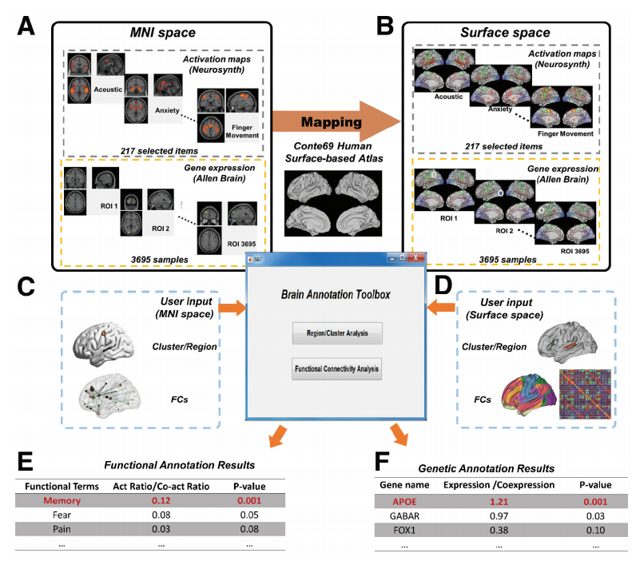
What is functional annotation
BAT可以对许多神经成像结果进行功能和基因注释，无论是在三维体积空间还是二维表面空间，以簇/区域或FCs的形式进行注释；
特别是，BAT可以为许多不同的知名大脑图谱提供功能和基因注释，如Brodmann 、AAL 2和Craddock 200。

Slide 26
Results
A total of 1278 subjects from five different institutes or cohorts (320 first-episode drug-naive and 294 chronic schizophrenia patients, 99 CHR subjects, and 565 matched health controls) were involved after quality control, including one primary FES dataset, two validation FES datasets, three chronic dataset, and one CHR dataset. (5 institutes, 7 datasets).

Slide 27
Results
Heterogeneity of IDSCNs in first-episode schizophrenia patients
The number of edges in each patient’s IDSCN that were significantly different from the reference network (P < 0.05, Bonferroni corrected for 4317 edges) range from 0 to 151 (i.e., 0~3.45% of the total 4317 edges) with a mean of 17.3 ± 25.9 (SD) edges.
Among all 4317 edges, 1367 were found to be significantly changed in at least one of the patients and only 384 out of the 1367 edges were shared by at least two patients. This was supplemented by the low similarity among the IDSCN profile of patients (the between-subjects Pearson correlation among the pairwise Z-scores across all the 4317 edges, the mean correlation being 0.0183 ± 0.0689). (异质性)
Whilst patients did not exhibit notable overlap in their IDSCNs, the regions constituting the fronto-temporo-parietal network were often affected. To prioritize the most affected nodes, we used the 1367 edges that were significantly changed in at least one patient and calculated the degree of each node (the number of edges connecting to it) in the network. The top 10 brain regions with the largest extent of change, including several regions from the fronto-temporo-parietal network.
Furthermore, the higher number of altered edges in their IDSCNs was significantly correlated with higher burden of hallucinations in the PANSS (r= 0.3166, P= 0.0011).

Slide 28
Results
The relationship between IDSCNs and group-level structural covariance networks
We constructed group-level structural covariance network for control and patient group, respectively, in the primary FES dataset. We defined the group-level difference network dif_{group} as the normalized difference between the two group-level networks.
We also calculated the mean of IDSCNs, i.e., dif_{individual_mean.} The Pearson correlation between dif_{group} and dif_{individual_mean} is 0.7496. However, each individual’s IDSCN demonstrates a low correlation with the group-level difference network dif_{group} (r= 0.1901 ± 0.0946), suggesting that the accumulated individual difference contributes the group-level difference, but each individual contributes to the group-level difference in a different way.

Slide 29
Results
Two subgroups of patients with significant difference in depression and anxiety symptoms
Among the top 20 edges, 10 showed significant differences in their Z-score (P < 0.05, Bonferroni corrected) between the two subgroups of patients. These ten edges can be separated into two categories with opposite direction of changes among the two subgroups of patients
The first category of edges (five edges, indicated by blue star) connected the left hippocampus with the bilateral putamen and pallidum that showed the most significant difference between the two subgroups of patients and another edge connecting the right pallidum with the right fusiform cortex.
The second category of edges (five edges, indicated by orange double stars) connected the left middle occipital gyrus with the left rectus, posterior orbitofrontal cortex, and the superior temporal gyrus, and included edges that connected the left superior temporal cortex with the inferior occipital gyrus and right posterior orbitofrontal cortex.

Slide 30
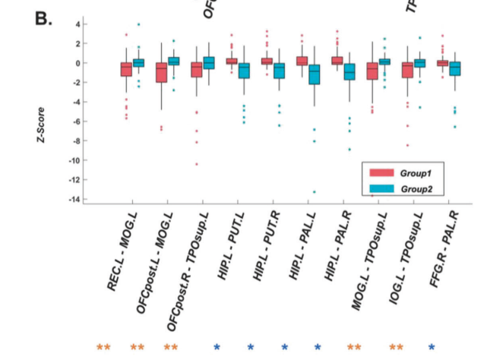
Results
Two subgroups of patients with significant difference in depression and anxiety symptoms
Among the top 20 edges, 10 showed significant differences in their Z-score (P < 0.05, Bonferroni corrected) between the two subgroups of patients. These ten edges can be separated into two categories with opposite direction of changes among the two subgroups of patients
The first category of edges (five edges, indicated by blue star) connected the left hippocampus with the bilateral putamen and pallidum that showed the most significant difference between the two subgroups of patients and another edge connecting the right pallidum with the right fusiform cortex.
The second category of edges (five edges, indicated by orange double stars) connected the left middle occipital gyrus with the left rectus, posterior orbitofrontal cortex, and the superior temporal gyrus, and included edges that connected the left superior temporal cortex with the inferior occipital gyrus and right posterior orbitofrontal cortex.

Slide 31
Results
Two subgroups of patients with significant difference in depression and anxiety symptoms
Among the top 20 edges, 10 showed significant differences in their Z-score (P < 0.05, Bonferroni corrected) between the two subgroups of patients. These ten edges can be separated into two categories with opposite direction of changes among the two subgroups of patients
The first category of edges (five edges, indicated by blue star) connected the left hippocampus with the bilateral putamen and pallidum that showed the most significant difference between the two subgroups of patients and another edge connecting the right pallidum with the right fusiform cortex.
The second category of edges (five edges, indicated by orange double stars) connected the left middle occipital gyrus with the left rectus, posterior orbitofrontal cortex, and the superior temporal gyrus, and included edges that connected the left superior temporal cortex with the inferior occipital gyrus and right posterior orbitofrontal cortex.

Slide 32
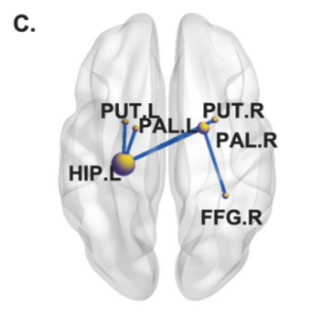
Results
Two subgroups of patients with significant difference in depression and anxiety symptoms
Among the top 20 edges, 10 showed significant differences in their Z-score (P < 0.05, Bonferroni corrected) between the two subgroups of patients. These ten edges can be separated into two categories with opposite direction of changes among the two subgroups of patients
The first category of edges (five edges, indicated by blue star) connected the left hippocampus with the bilateral putamen and pallidum that showed the most significant difference between the two subgroups of patients and another edge connecting the right pallidum with the right fusiform cortex.
The second category of edges (five edges, indicated by orange double stars) connected the left middle occipital gyrus with the left rectus, posterior orbitofrontal cortex, and the superior temporal gyrus, and included edges that connected the left superior temporal cortex with the inferior occipital gyrus and right posterior orbitofrontal cortex.

Slide 33
Results
Two subgroups of patients with significant difference in depression and anxiety symptoms
Among the top 20 edges, 10 showed significant differences in their Z-score (P < 0.05, Bonferroni corrected) between the two subgroups of patients. These ten edges can be separated into two categories with opposite direction of changes among the two subgroups of patients
The first category of edges (five edges, indicated by blue star) connected the left hippocampus with the bilateral putamen and pallidum that showed the most significant difference between the two subgroups of patients and another edge connecting the right pallidum with the right fusiform cortex.
The second category of edges (five edges, indicated by orange double stars) connected the left middle occipital gyrus with the left rectus, posterior orbitofrontal cortex, and the superior temporal gyrus, and included edges that connected the left superior temporal cortex with the inferior occipital gyrus and right posterior orbitofrontal cortex.

Slide 34
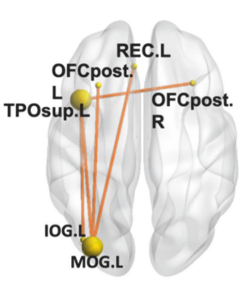
Results
Two subgroups of patients with significant difference in depression and anxiety symptoms
Among the top 20 edges, 10 showed significant differences in their Z-score (P < 0.05, Bonferroni corrected) between the two subgroups of patients. These ten edges can be separated into two categories with opposite direction of changes among the two subgroups of patients
The first category of edges (five edges, indicated by blue star) connected the left hippocampus with the bilateral putamen and pallidum that showed the most significant difference between the two subgroups of patients and another edge connecting the right pallidum with the right fusiform cortex.
The second category of edges (five edges, indicated by orange double stars) connected the left middle occipital gyrus with the left rectus, posterior orbitofrontal cortex, and the superior temporal gyrus, and included edges that connected the left superior temporal cortex with the inferior occipital gyrus and right posterior orbitofrontal cortex.

Slide 35
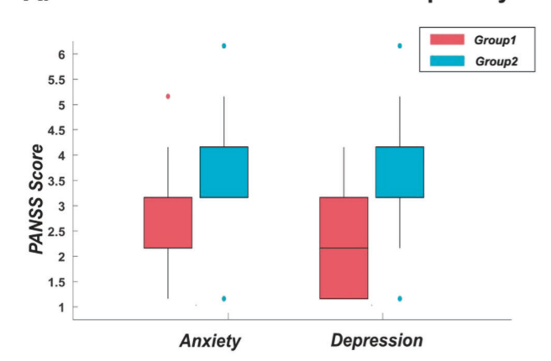
Results
Two subgroups of patients with significant difference in depression and anxiety symptoms
The two subgroups of patients also exhibited significant differences in their anxiety and depression symptoms on the PANSS general scale (P= 0.0012 and 1.03e^{–04}), but did not show significant differences in their sex, age, education, or illness duration (P= 0.7514, 0.7309, 0.7410, and 0.2696, respectively).

Slide 36
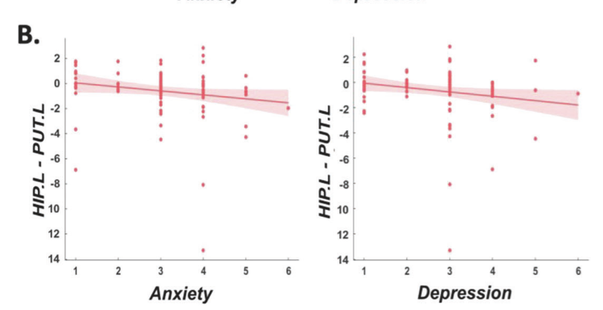
Results
Two subgroups of patients with significant difference in depression and anxiety symptoms
Three of the ten edges were significantly correlated with the anxiety or depression score and the Z-score for the edge that connected left hippocampus and left putamen was most significantly negatively correlated with both scores (r=−0.30, P= 0.0021 and r=−0.24, P= 0.0140, respectively), see Fig. 3 for details.

Slide 37
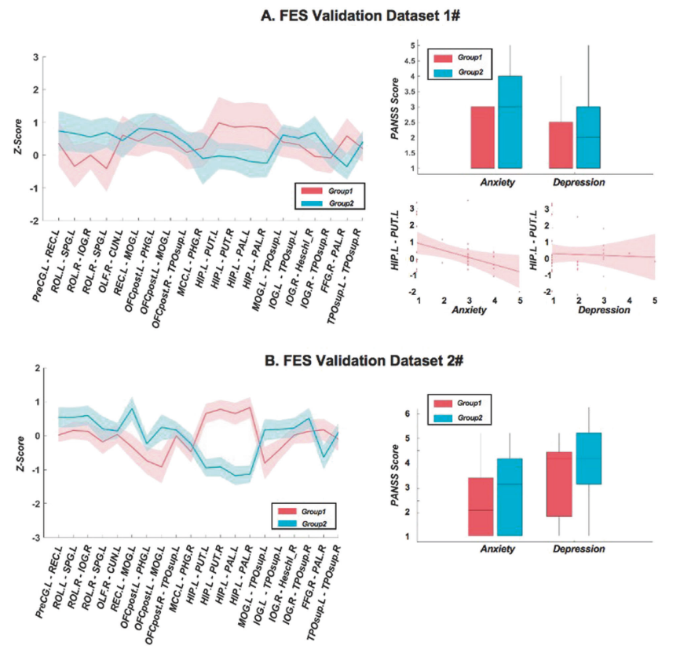
Results
Validation in two independent first-episode schizophrenia datasets
We constructed IDSCNs for patients in two FES validation datasets and used Z-score of the top 20 edges identified in the primary FES dataset to perform the same clustering analysis. All the two validation datasets showed similar differences in pattern between two patient subgroups as that in the primary dataset, see Fig. 4.
For the ten edges showing significant subgroup difference in FES dataset, five of them showed significant difference between two subgroups for both validation datasets.
Using patients having PANSS scores (32 subjects in Validation dataset #1, 41 subjects in Validation dataset #2), we further replicated that the subgroup differences in the anxiety and depression score in both of the two validation datasets were in the same direction as in the primary FES dataset, with the subgroup difference in depression score being significant for Validation dataset #2 (P=0.0122). The Z-score of the edge that connecting left hippocampus and left putamen was consistently negatively correlated with depression and anxiety scores in the two validation datasets and the correlation was significant in the Validation dataset #1 (r=−0.4696, P=0.0367, Fig. 4A right panel).

Slide 38
Results
Validation in two independent first-episode schizophrenia datasets
We constructed IDSCNs for patients in two FES validation datasets and used Z-score of the top 20 edges identified in the primary FES dataset to perform the same clustering analysis. All the two validation datasets showed similar differences in pattern between two patient subgroups as that in the primary dataset, see Fig. 4.
For the ten edges showing significant subgroup difference in FES dataset, five of them showed significant difference between two subgroups for both validation datasets.
Using patients having PANSS, we further replicated that the subgroup differences in the anxiety and depression score in both of the two validation datasets were in the same direction as in the primary FES dataset, with the subgroup difference in depression score being significant for Validation dataset #2 (P=0.0122). The Z-score of the edge that connecting left hippocampus and left putamen was consistently negatively correlated with depression and anxiety scores in the two validation datasets and the correlation was significant in the Validation dataset #1 (r=−0.4696, P=0.0367, Fig. 4A right panel).

Slide 39
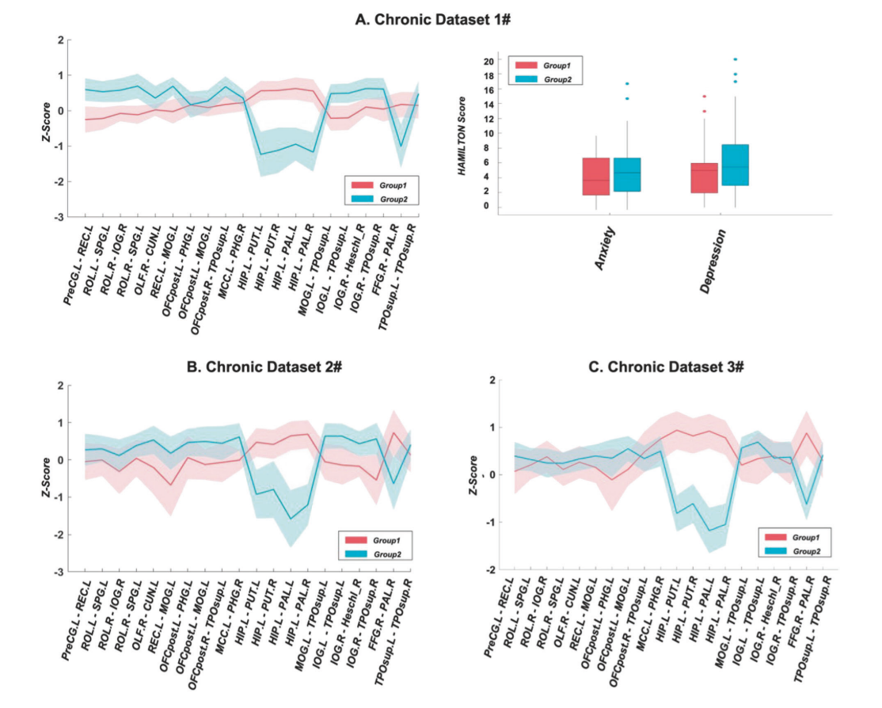
Results
Stability across different stages of schizophrenia
We constructed IDSCN for another four datasets, including three Chronic Datasets #1-3, and a CHR Dataset, and performed k-means clustering using the same 20 edges previously identified in FES.
For chronic schizophrenia, all three datasets showed similar subgroup difference pattern as the primary FES dataset in the top 20 edges, see Fig. 5A–C. Importantly, for the ten edges that showed significant subgroup difference in FES dataset, five edges show consistently significant subgroup differences for all three chronic datasets (see Supplementary Table S4 for details). For chronic Dataset #1 with the clinical score, we found that the differences between the two subgroups of patients in anxiety and depression scores were also in the same direction as that validated in the FES dataset, see Fig. 5A. Finally, for the ten edges showing significant subgroup difference in the primary FES dataset, they showed a very similar subgroup difference pattern across all six FES and chronic datasets (r= 0.9709 ± 0.0115, see Fig. 5D).

Slide 40
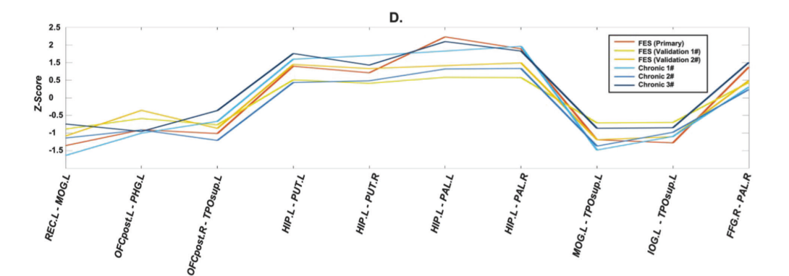
Results
Stability across different stages of schizophrenia
We constructed IDSCN for another four datasets, including three Chronic Datasets #1-3, and a CHR Dataset, and performed k-means clustering using the same 20 edges previously identified in FES.
For chronic schizophrenia, all three datasets showed similar subgroup difference pattern as the primary FES dataset in the top 20 edges, see Fig. 5A–C. Importantly, for the ten edges that showed significant subgroup difference in FES dataset, five edges show consistently significant subgroup differences for all three chronic datasets.
For chronic Dataset #1 with the clinical score, we found that the differences between the two subgroups of patients in anxiety and depression scores were also in the same direction as that validated in the FES dataset, see Fig. 5A.
Finally, for the ten edges showing significant subgroup difference in the primary FES dataset, they showed a very similar subgroup difference pattern across all six FES and chronic datasets (r= 0.9709 ± 0.0115, see Fig. 5D).

Slide 41
Results
Functional implications of the covariance edges significantly different between two patient subtypes
To further validate the finding maybe the underlying neural substrate of affective behavior, we performed a functional annotation analysis for the ten edges showing significant difference between two patient subgroups using the Neurosynth database.
Specifically, we used Brain Annotation Toolbox, which transformed the voxel-level functional knowledge from Neurosynth to provide a network-level functional annotation. Functional terms were found to be significantly enriched with BHFDR < 0.05. Among the top 10 terms, 7 were closely related to anxiety/depression, which validated our findings that the altered structural covariance correlated with anxiety and depression symptom scores.
Notes:
What is the functional knowledge??

Slide 42
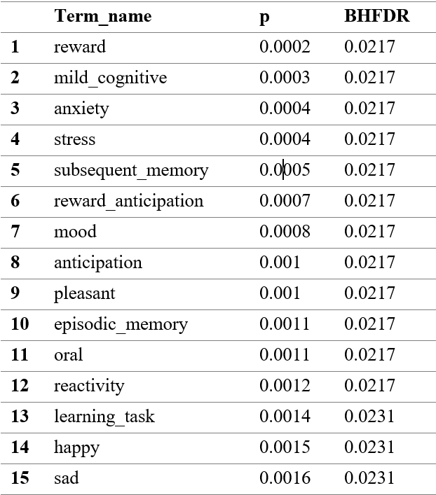
Results
Functional implications of the covariance edges significantly different between two patient subtypes
To further validate the finding maybe the underlying neural substrate of affective behavior, we performed a functional annotation analysis for the ten edges showing significant difference between two patient subgroups using the Neurosynth database.
Specifically, we used Brain Annotation Toolbox, which transformed the voxel-level functional knowledge from Neurosynth to provide a network-level functional annotation. Functional terms were found to be significantly enriched with BHFDR < 0.05. Among the top 10 terms, 7 were closely related to anxiety/depression, which validated our findings that the altered structural covariance correlated with anxiety and depression symptom scores.
Notes:
What is the functional knowledge??

Slide 43
Results
Genetic basis for the altered covariance edge by GWAS analysis
To identify the genetic basis of the covariance edge connecting the left hippocampus with the left putamen, we used the Z-score of the edge in each patient’s IDSCN as the phenotype and performed the GWAS analysis.
Five SNPs were identified to be significantly associated with the edge, surviving the Bonferroni correction for all the 185,144 SNPs at the P=0.05 level. The five SNPs related to four genes (POGK, TADA1, SP4, and ZNF778) in chromosomes 1, 7, and 16, respectively.
With an FDR threshold <0.1, 28 SNPs in 20 genes were identified to be significantly associated with the edge.
Furthermore, we performed a functional enrichment analysis for the 20 genes using the EnrichR website and found that several biological processes related to major histocompatibility complex (MHC) class were significantly enriched, including regulation of the MHC class II biosynthetic process (P=3.50e^{–5}) and regulation of the MHC class I biosynthetic process (P=0.0070). HDAC2 and CIITA are two genes involved in these processes. HDAC2 has been shown to play a role in regulating synapse formation and synaptic plasticity in the hippocampus.
Notes:
富集分析:富集分析原理是什么？ 基因功能富集分析，是指借助各类数据库和分析工具进行统计分析，挖掘在数据库中与我们要研究的生物学问题具有显著相关性的基因功能类别。
此外，我们使用 EnrichR 网站对 20 个基因进行了功能富集分析，发现与主要组织相容性复合体 (MHC) 类相关的几个生物过程显着富集，包括对 MHC II 类生物合成过程的调节 (P=3.50e– 5) 和 MHC I 类生物合成过程的调节 (P=0.0070)。 HDAC2 和 CIITA 是参与这些过程的两个基因。 HDAC2 已被证明在调节海马突触形成和突触可塑性方面发挥作用。

Slide 44
Thanks for your listening! Any question or comment?

